Slide 1


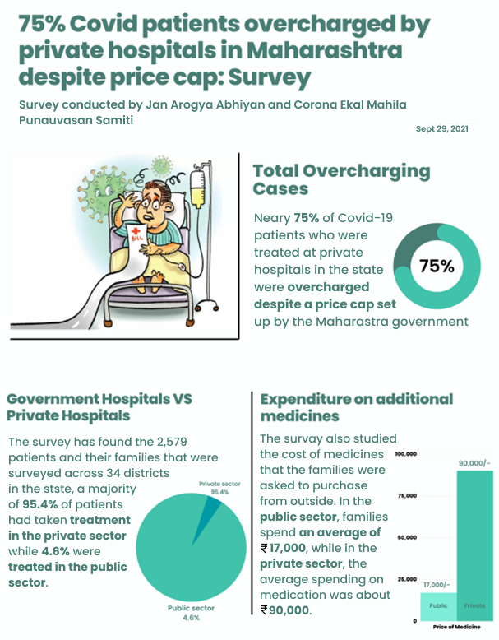
SMART INDIA HACAKATHON 2022
CURRENT SCENARIO :
India has a total of 43,486 private hospitals. Total private infrastructure accounts for nearly 62% of all India's health infrastructure.
Private Hospitals are registered and accredited under Clinical Establishment Act.
Clinical Establishment Act is adopted by a total of 17 states and union territories.
Under The Clinical Establishment Act, State medical councils are created to regulate hospitals.
Grievances and Complaints against private hospitals are managed by State and Indian medical Council.
During Covid, Hospital exploited patients by charging huge and unimaginable amounts.
Patients were held hostages until bills were paid.
Organization
Defense Research and Development Organization (DRDO)
PS Code
NR1168
Problem Statement
Develop Solution/Application to regulate Private health care sector in India from exploiting people during medical emergencies and pandemic situations.
Team Name
Team Ayushyaman
Team Leader
Bhavesh Anandpara
Institute Code (AISHE)
C-58531
Source : https://rb.gy/zl6n84
OBJECTIVES :
Develop a National Information Portal to disseminate hospital information along with their medical treatment /surgery rates .
Provide real-time information about availability of beds and emergency consumables.
Provide details of rates, treatment and medical facilities available as provided by the hospitals across the country to guide the citizens to get affordable medical emergency services as per choice and availability.
Gather reliable and comprehensive data about hospitals through Feedback forms of patients to prevent exploitation as per ethical guidelines of medical council of India.
Evaluate hospitals on certain parameters to analyze and help authorities to take necessary actions.
Institute Name
: Bajaj Institute Of Technology
Theme Name
: MedTech/Biotech/HealthTech
REFERERNCE :
Codes Of Ethics Regulation : https://rb.gy/zfoyf7
Clinical Establishment Act : https://rb.gy/0dz1d8

Slide 2















SOLUTION :
Developing a National Information Portal ( AYUSHMAN ) for providing information related to hospitals and medical facilities available there as well as generating statistical data to help regulatory authorities analyze hospital performance.
Hospitals will be provided dashboard to fill information like total numbers of beds, doctors, staff, ambulances, etc. once and update emergency information like bed count, oxygen, etc. frequently. Hospitals can update emergency bed count manually or can update automatically using the Real-Time Update Module via APIs and Database Triggers, so when operator at the hospital Admits or Discharge patients through their management software (ERP) it will directly reflect on our portal.
Cost Approximation Module is developed to get an Approximate range of cost for a specific surgery/ medical treatment for a specific hospital based on Rates provided by hospitals and a dataset created based on feedback received from previous patients.
Feedback and Grievance Module will enable patients to report Grievances such as overcharging, abuse, etc. directly to the State medical council and enable them to give feedback for services/treatment provided. Patient will be asked to upload images of Bills including Treatment Bill, Pharmacy Bill and Discharge Summary which will be scanned through Optical Character Recognition ( OCR ) to get the necessary information such as Age, Gender, Costs, Generic drug recommendation, etc.
Generate Statistical report using proposed 5 point score module for each Hospital based on data collected from hospitals and feedback received. It will provide an opportunity for Hospitals to improve and help Regulating Authorities to analyze hospitals and take necessary /disciplinary actions.
ADD ON FEATURES :
STAKEHOLDERS
WhatsApp Chatbot :
Providing necessary (Hospital/Treatment) information to users with weak internet connection.
Sending Feedback forms through WhatsApp chatbot to increase the frequency of Feedback.
Shortest Route :
Provides Shortest Route to the Hospital Using Google Maps.
In Emergency Situation like Labor, Accident, etc. user can check for the nearest hospital.
TECHNOLOGY STACK
WhatsApp Chatbot

Slide 3
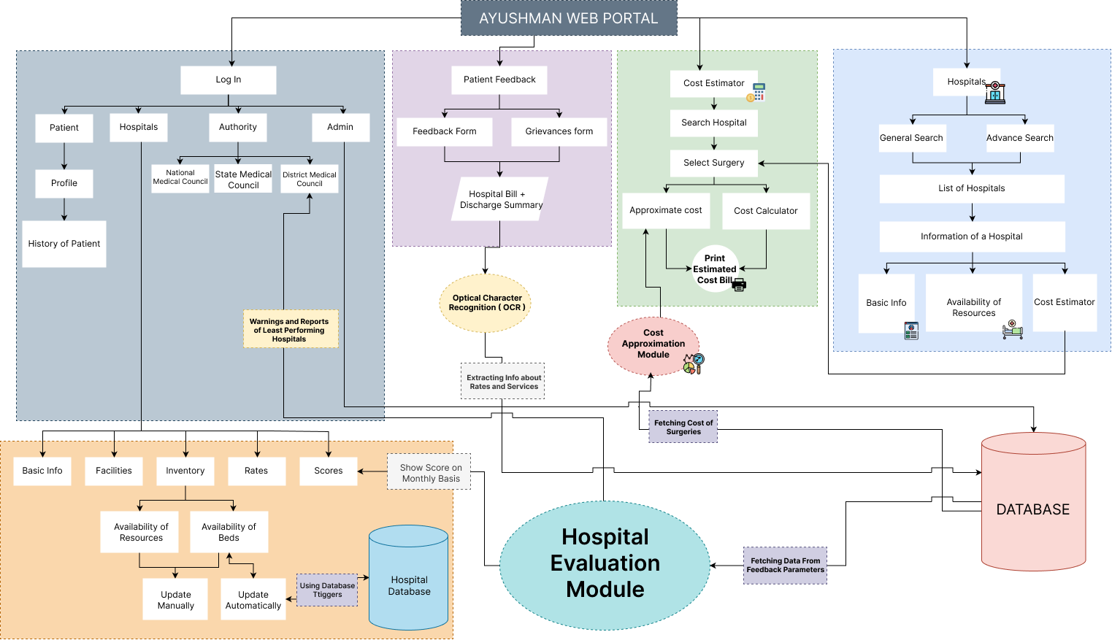





Cost Approximation Module
Cost Approximation Module provides approximate range of cost for surgery/medical treatment at a specific hospital. Dataset for the same will be created by information provided by Hospitals and by scanning Hospital Bills, Pharmacy Bills and Discharge Summary through OCR fetched from the feedback of previous patients.
Steps Involved
Getting Rates from Hospitals and by Hospital Bills + Discharge Summary of Patient through their feedback and grievances form.
Scanning Bills Using Optical Character Recognition ( OCR ).
Creating a dataset based on Cost, Sex, Age, Medical Conditions, etc. for better approximation.
Based on this Cost Approximation Module Will Give the User an Approximate Bill for a Surgery.
Modules :
Cost Approximation Module to show approximate cost based on previous patients data.
Feedback and Grievance Module to collect information through bills and discharge summary.
Real-Time update module to update availability of bed on real-time via APIs and Database Triggers.
5 Point Score Module to evaluate hospitals on certain parameters helping authorities to take necessary actions.

Slide 4

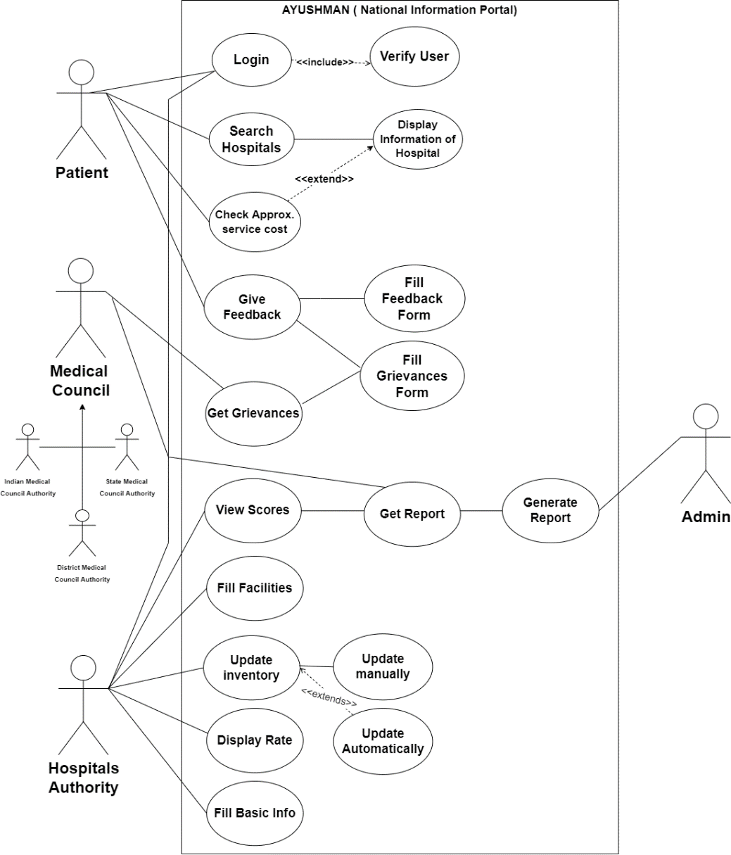








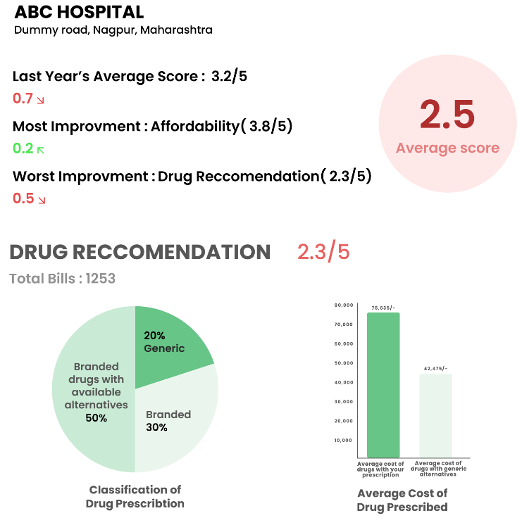

5 POINT SCORE MODULE
USE CASE :
5 Point Score Module is based on 5-Point Likert Scale where based on data collected from previous patients and hospitals, it will generate a statistical report. The monthly report will be forwarded to hospitals and state medical council for authorities to analyze the Hospital performance on following parameters and based on that take necessary action required.
Proposed Parameters For Evaluation :
Sanitization
Affordability
Doctor-to-Patient Ratio
Drug Recommendation
Patient Satisfaction
Other Satistatical Data :
Classification of Bills
Bed Occupancy Rate
Total Complaints
UI Sample Report of ABC Hospital.
FUTURE SCOPE :
Include different types of hospitals so that patient can have more options to compare.
Include pathology labs.
Standardized bill formats for hospitals to prevent any hidden or extra charges.

Slide 5
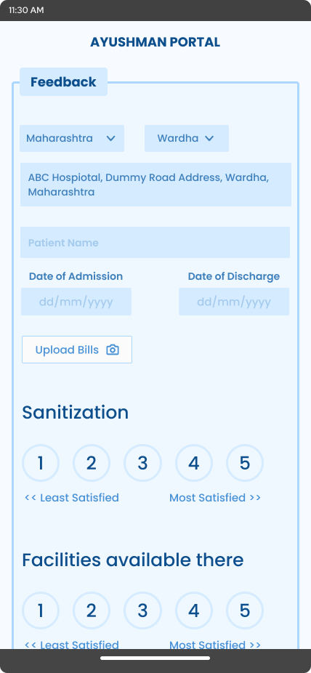
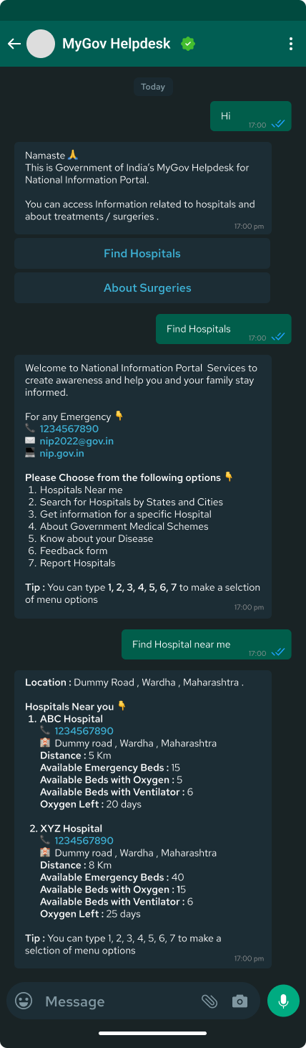
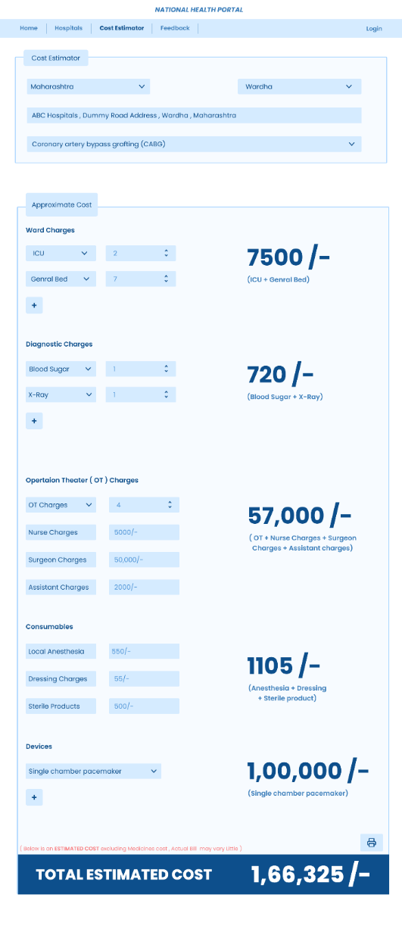
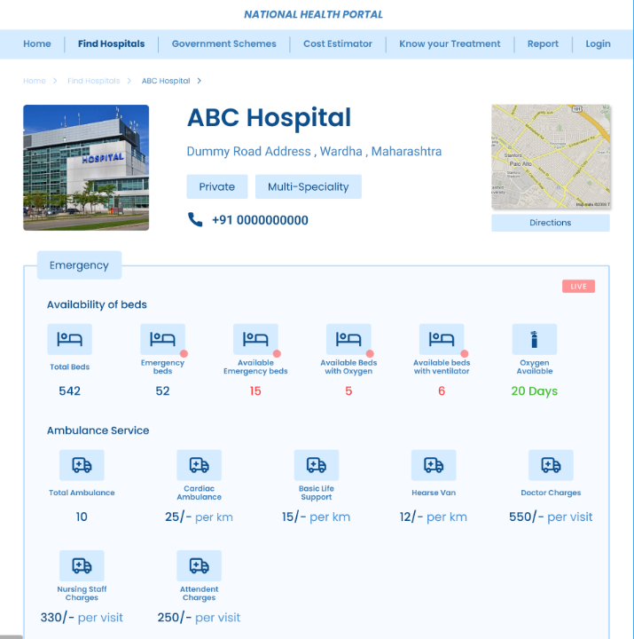
Feedback Module
WhatsApp Chatbot Screenshots
Cost Approximation Screenshots
Leader Name : Bhavesh Anandpara
Branch : B.Tech
Stream : Computer Engineering
Year : 2nd
As the rate of surgeries and treatment to the patient may vary according to the medical conditions of the patients.
Thus, To get the approximate charge the hospital apply to these patients, we ask patients to Upload bills of hospitals and pharmacy in the feedback form.
We will analyze the bills provided by the patients in the feedback form through OCR and store the data of charges applied by the hospital to the patients in database
After the discharge of the patient from the hospital, He will be notified to fill the feedback form through SMS or through WhatsApp Chatbot.
Member 1 : Vaishnavi Bhende
Branch : B.Tech
Stream : Computer Engineering
Year : 2nd
Member 2 : Vedanti Khode
Branch : B.Tech
Stream : Electrical Engineering
Year : 2nd
Member 3 : Shivam Charde
Branch : B.Tech
Stream : Computer Engineering
Year : 2nd
Hospital Profile
Member 4 : Pranjal Panchawate
Branch : B.Tech
Stream : Computer Engineering
Year : 2nd
Conclusion
Even in this digital era there is very insufficient data available for hospitals, so through AYUSHMAN we are collecting data and using it in such a way that we can prevent hospitals from exploiting patients.
Member 5 : Chanchal Hiwanj
Branch : B.Tech
Stream : Computer Engineering
Year : 2nd

